Slide 1
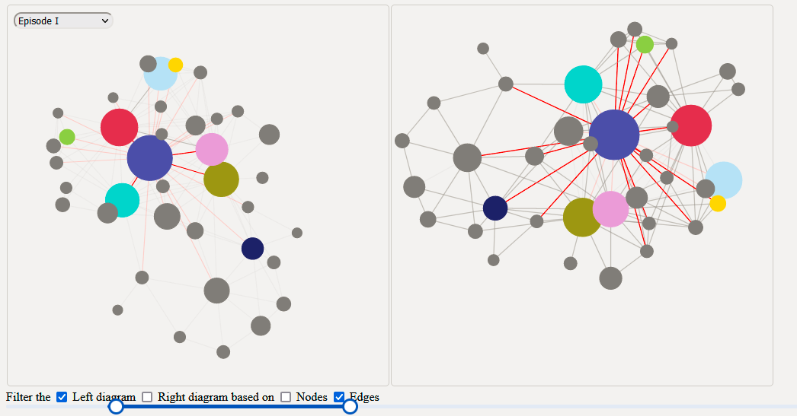
Assignment 4
Star Wars social network

Slide 2
Force-directed graph
Nodes: Name, number of scenes, colour
Size of nodes is proportional to number of scenes * arbitrary factor
Colour of nodes indicate importance of character
Links: Number of scenes in which where source and target have appeared together.
Stroke width is proportional to the number of scenes (source – target)
Notes:
a few slides to briefly explain your implementation, e.g., how you implemented it and the motivations behind the design and interactions.

Slide 3



Two instances of the graph

Slide 4

Control panel
Dropdown menu for selecting episode.
Slider, a range based filter. Applies to both windows.
Checkbox, attribute to filter, connected to slider. Applies to both windows.

Slide 5
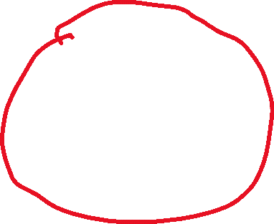

Linking
Clicking on a node highlights links on both windows.

Slide 6
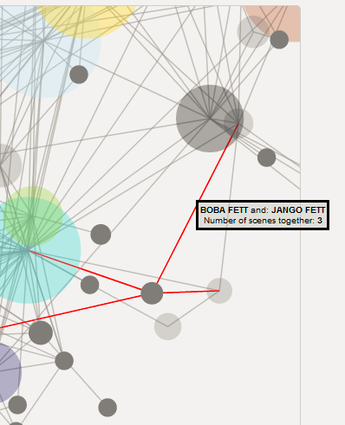
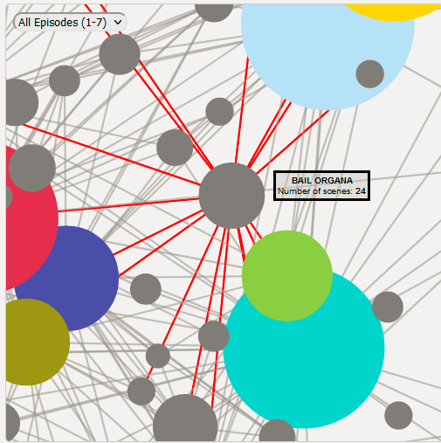
Details-on-demand
Tooltips on hover
Applies to both nodes and links.

